Slide 1
Artificial Intelligence Driven Meta-Analysis
Introduction to Meta Analysis
Dr. Wen-Wang Rao （饶文旺）
Lecturer
E-mail: raoww@mpu.edu.mo
Faculty of Applied Sciences
Macao Polytechnic University

Slide 2



Reminder for Group Project
1. Date of Final Report： Dec. 5, 2025
Deadline of Submission： 10.00 am
2. Date of Presentation：Dec. 12, 2025
Time : 10:00-13:00 and 19:00-22:00
Deadline of Submission： 10.00 am
E-mail: Dr. Rao: raoww@mpu.edu.mo
Notes:
You are required to download and complete a personal project, submitting it as either a PDF or Word document. Additionally, you must submit a separate "FCA Declaration on GenAI Usage" form, which can be in PDF or photo format.

Slide 3

Major Requirements for Group Project
Teams consist of 3 or 4 randomly assigned members
The project data will be released on Sep 12, 2026 (today)
Your team need to select a topic and utilize it to develop a detailed project.
Teams are required to submit the final project reports with a Turnitin report, the ppt or pdf of the presentation slides, the work contribution and Gen AI documents.
Teams should select their own presenter.
The project leader will submit all project files, and every member must submit a peer evaluation for the entire team.
For more details, please refer to the files in Canvas.
Notes:
You are required to download and complete a personal project, submitting it as either a PDF or Word document. Additionally, you must submit a separate "FCA Declaration on GenAI Usage" form, which can be in PDF or photo format.

Slide 4
Systematic Review And Meta-Analysis
A Step by Step guide Approach

Slide 5


Slide 6
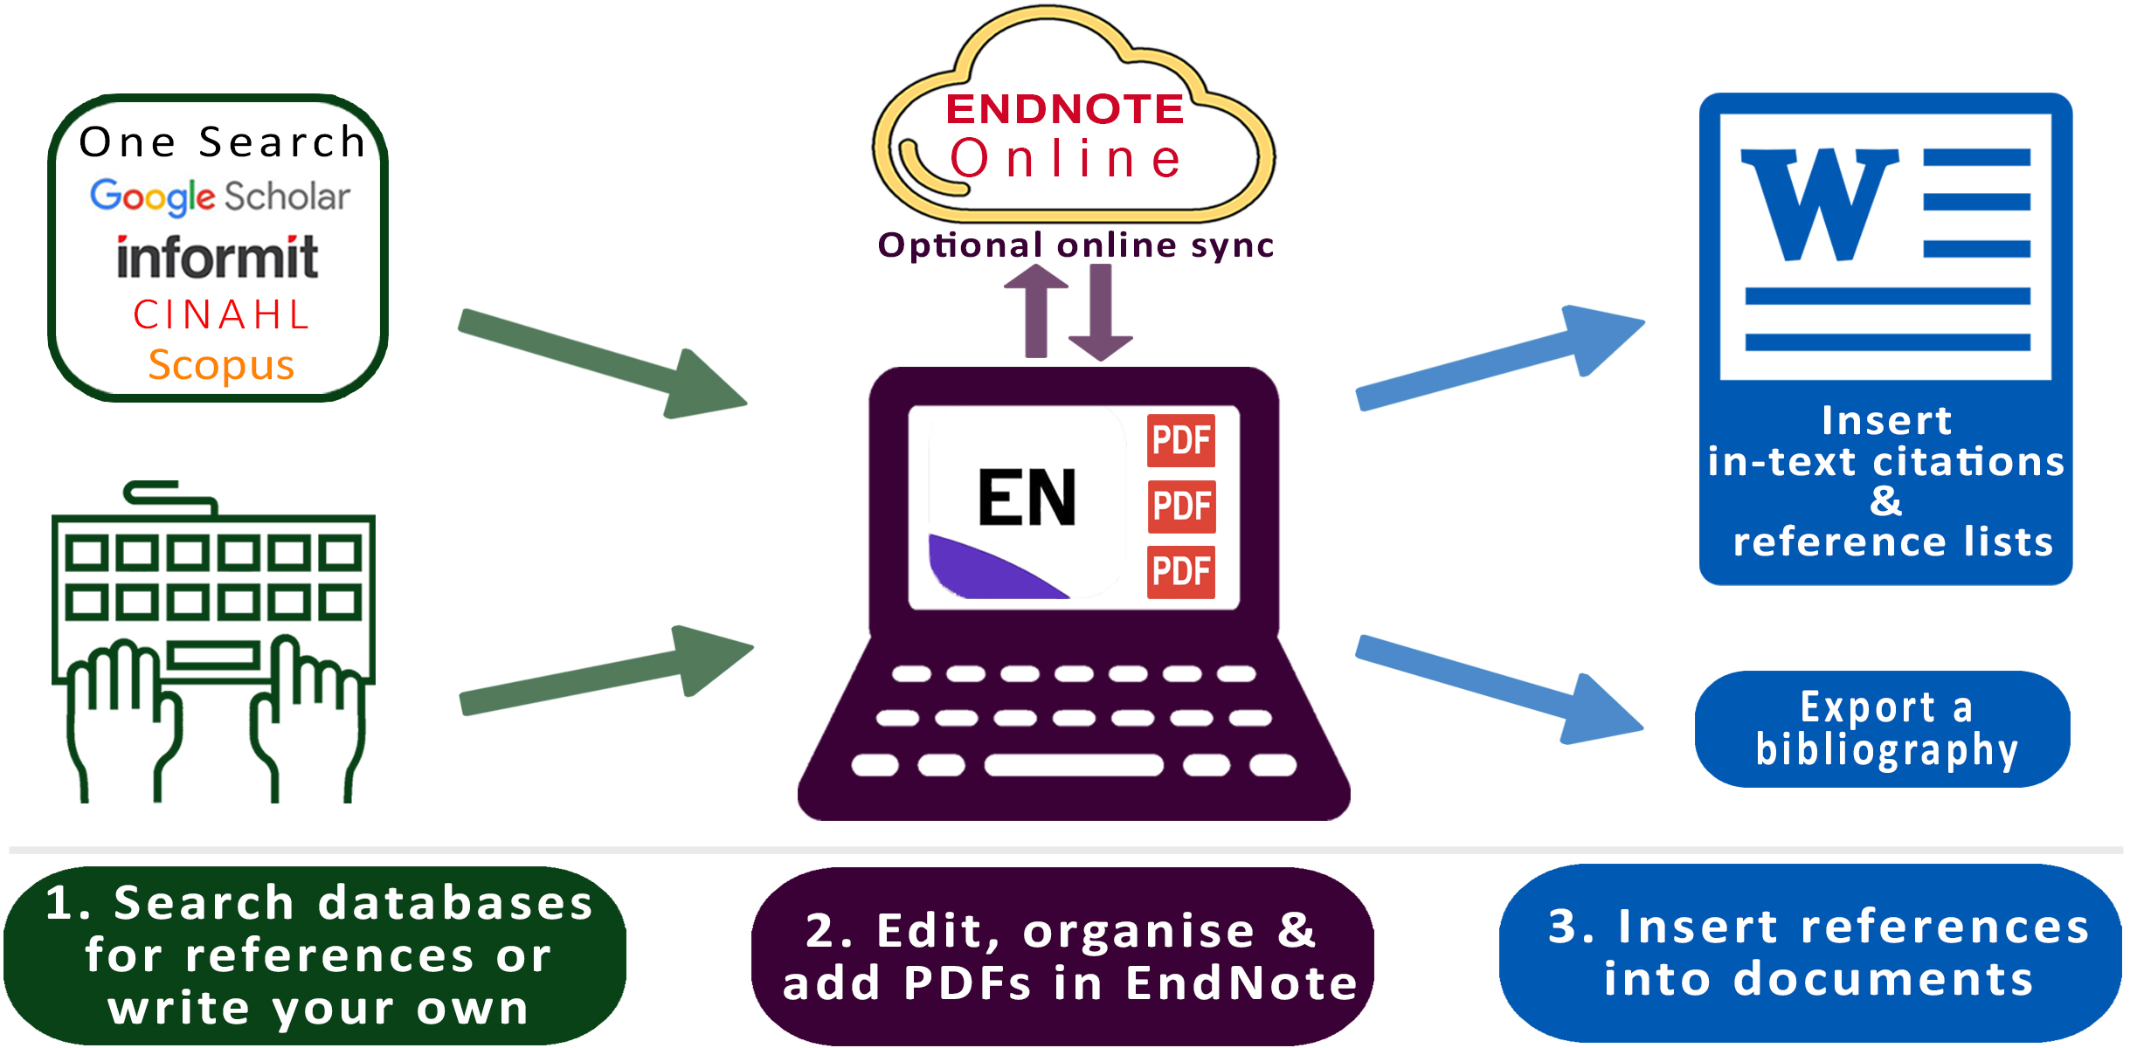

Slide 7
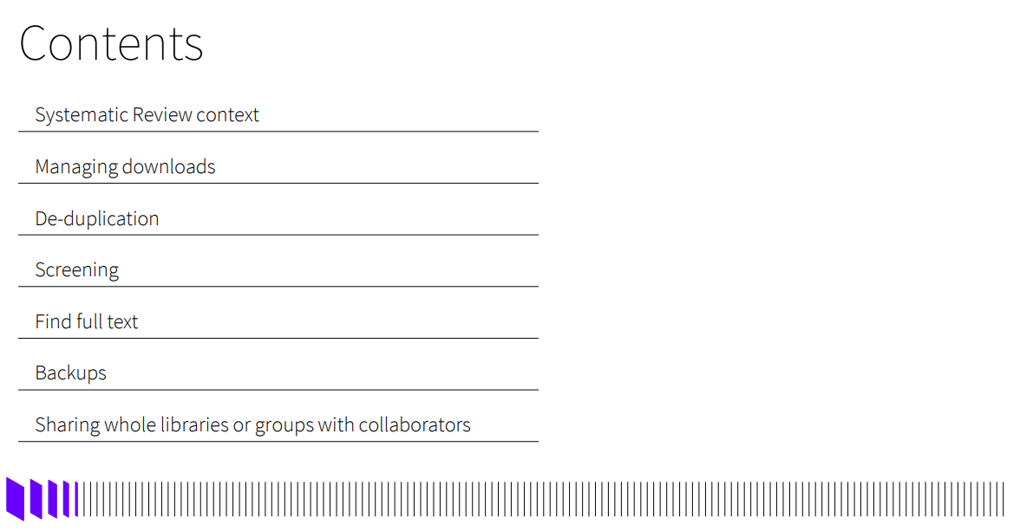

Slide 8
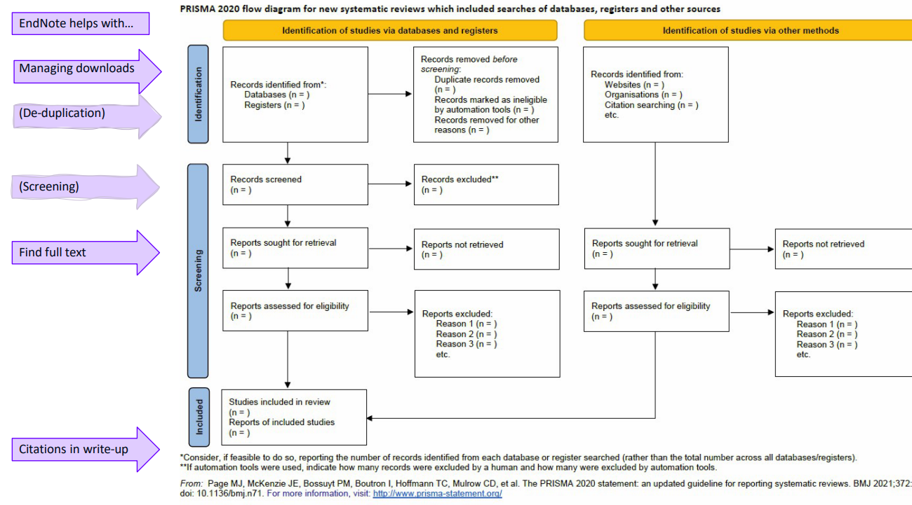

Slide 9
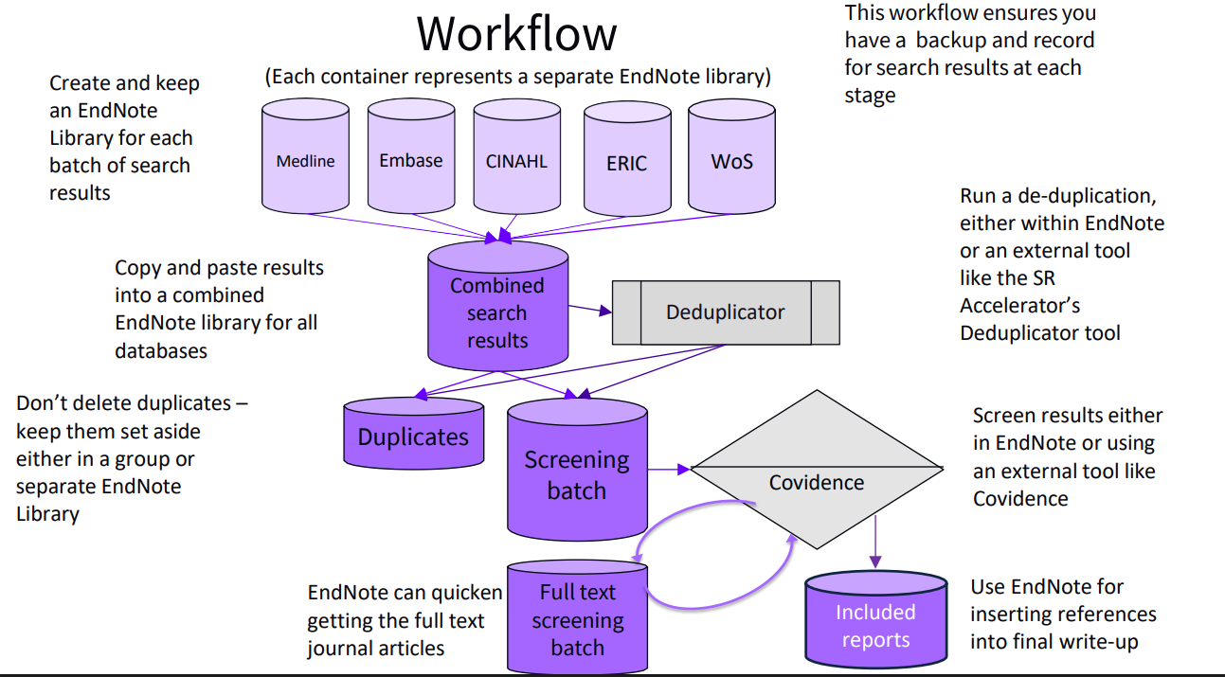

Slide 10
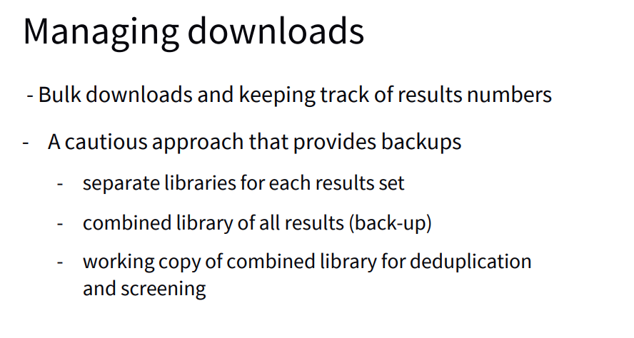

Slide 11
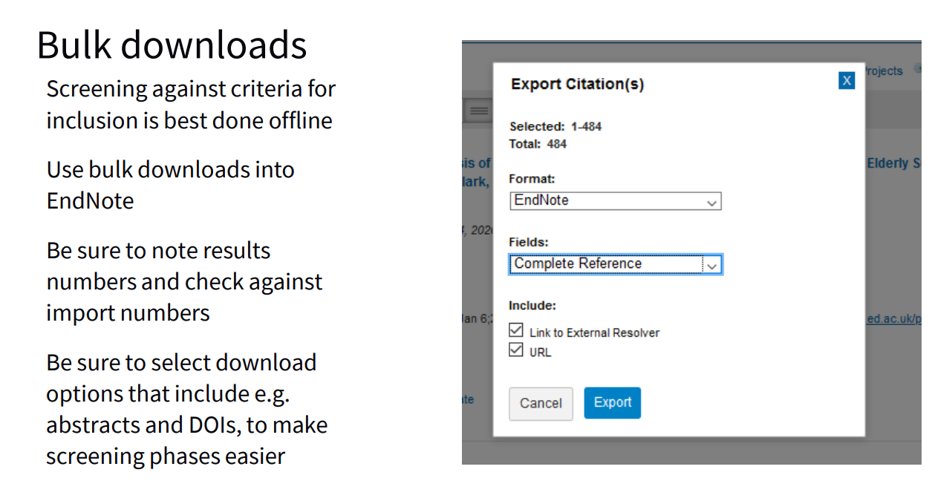

Slide 12
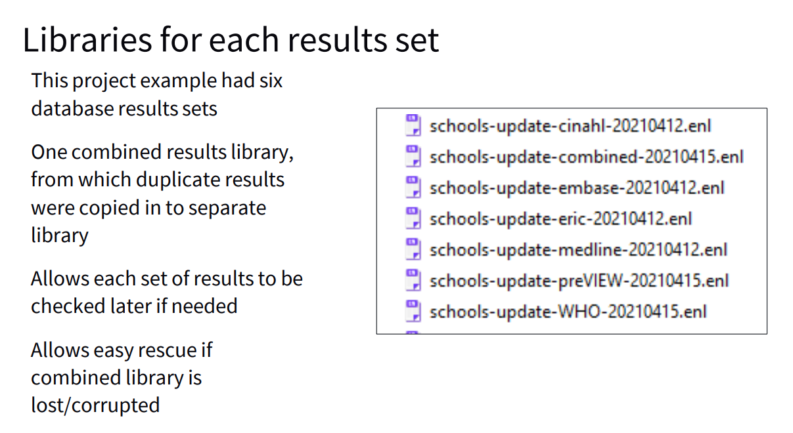

Slide 13
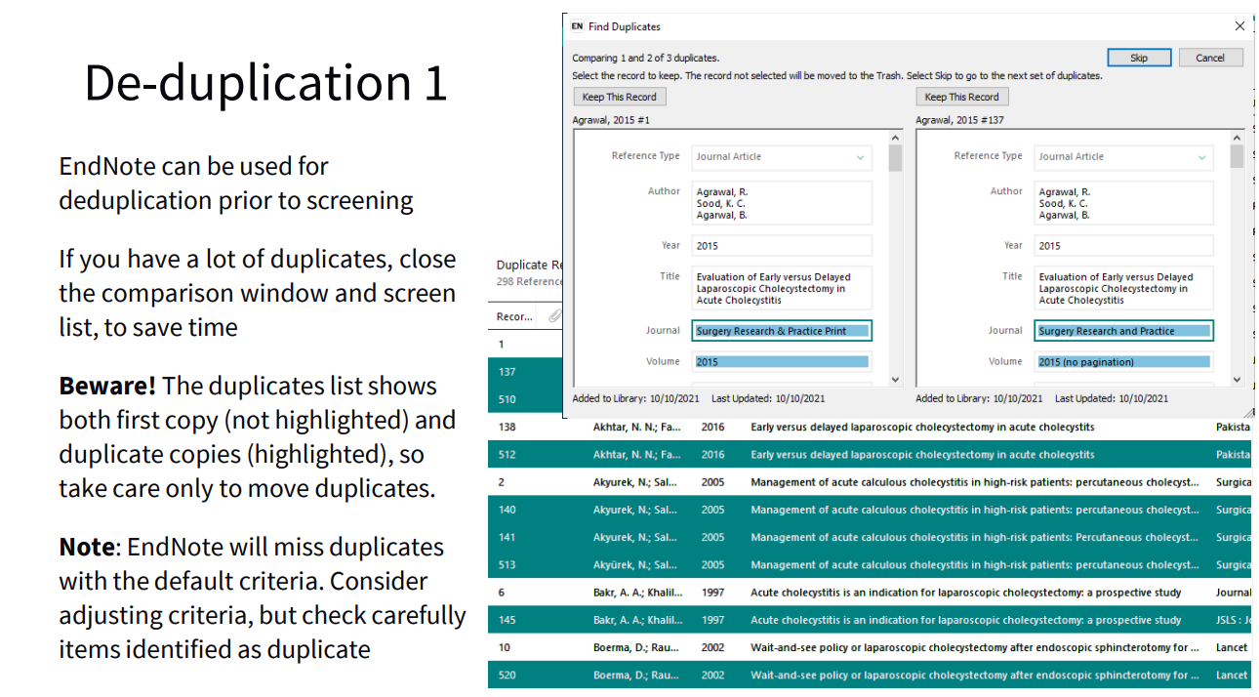

Slide 14
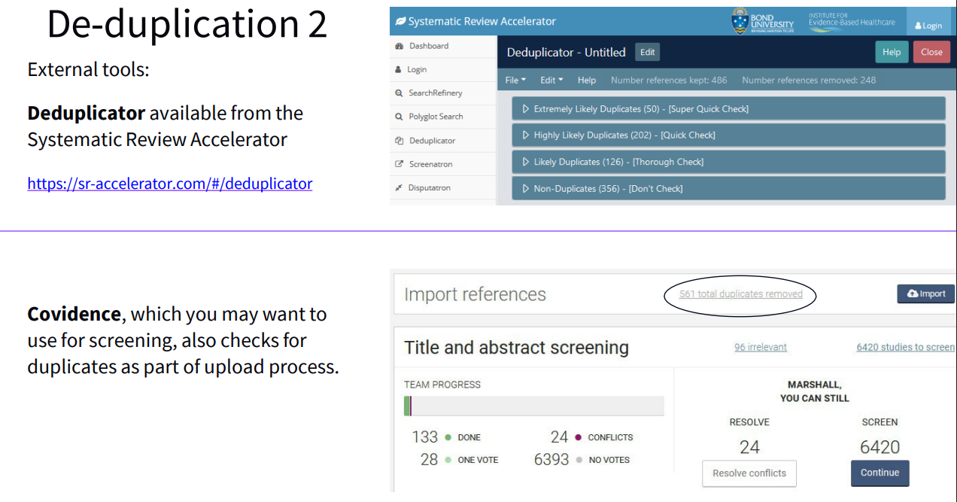

Slide 15
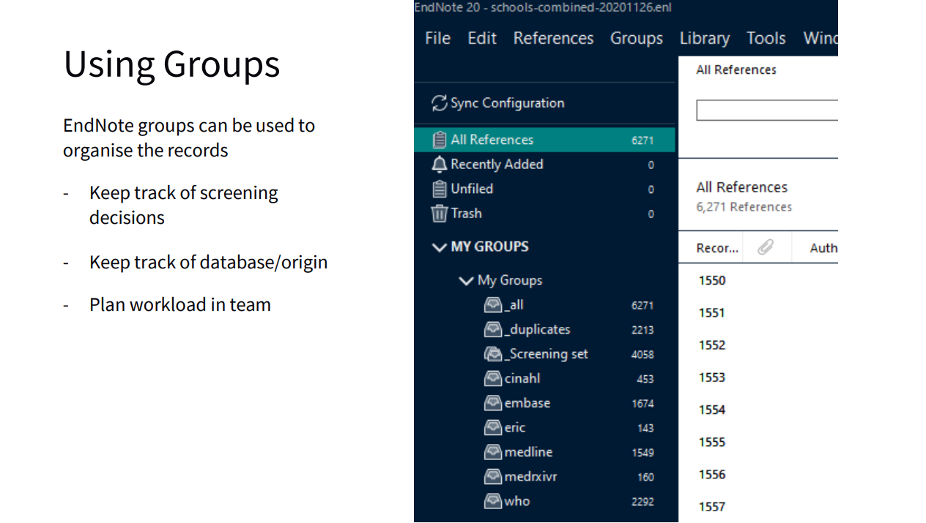

Slide 16
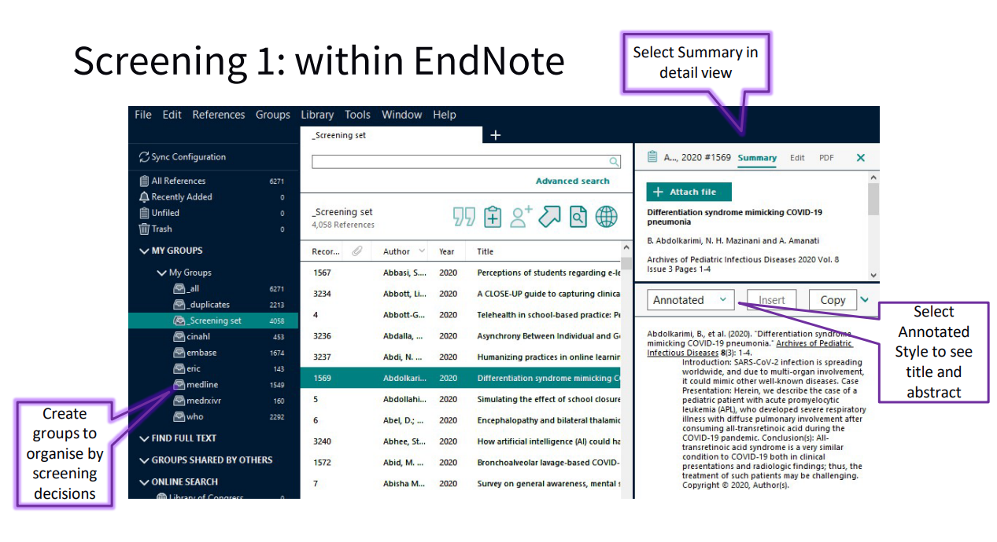

Slide 17
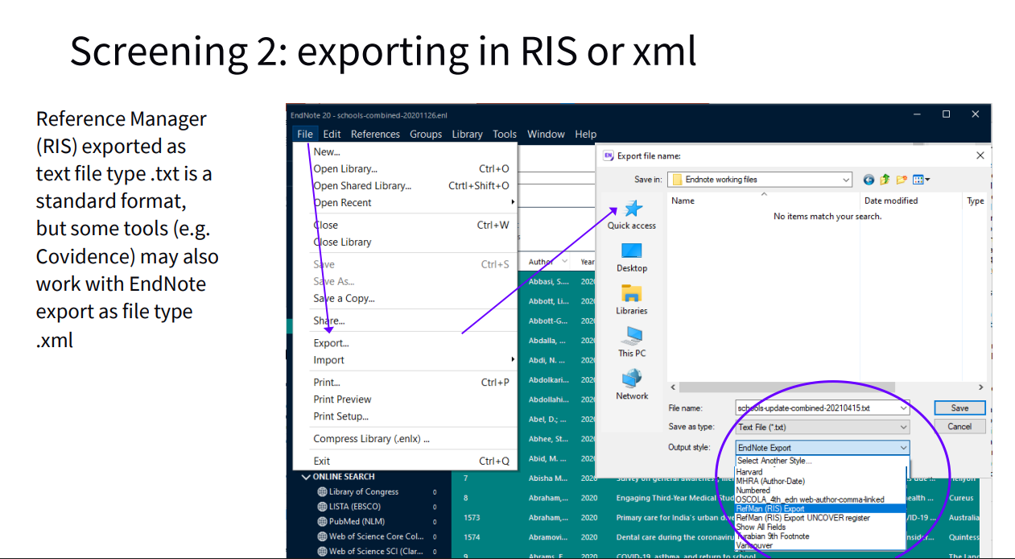

Slide 18
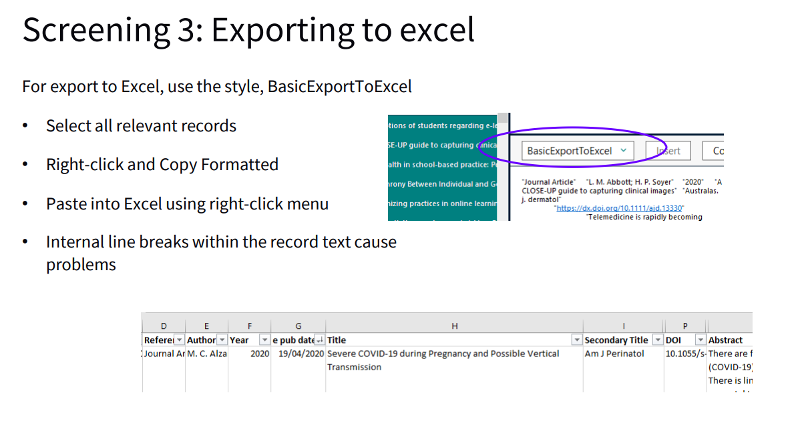

Slide 19
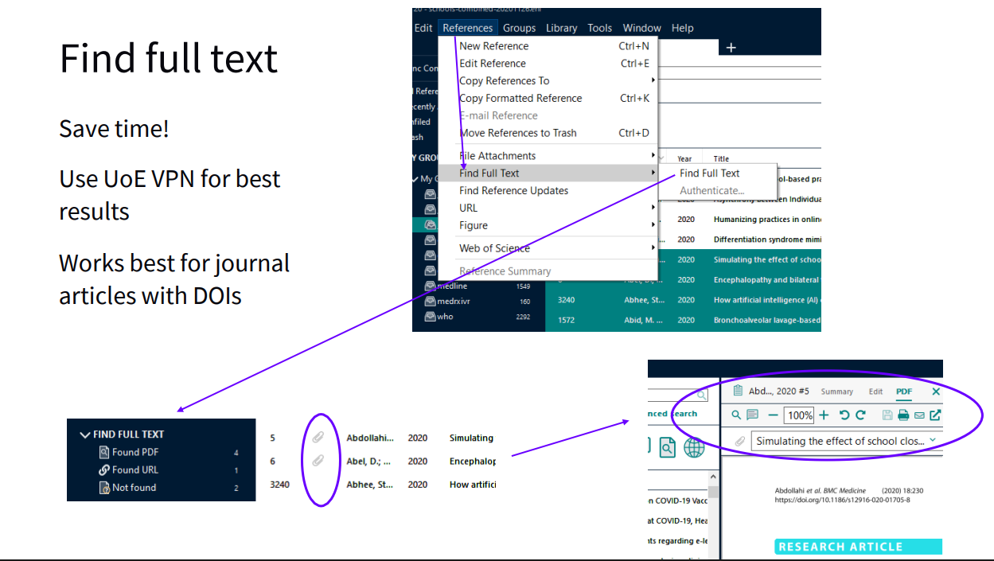

Slide 20
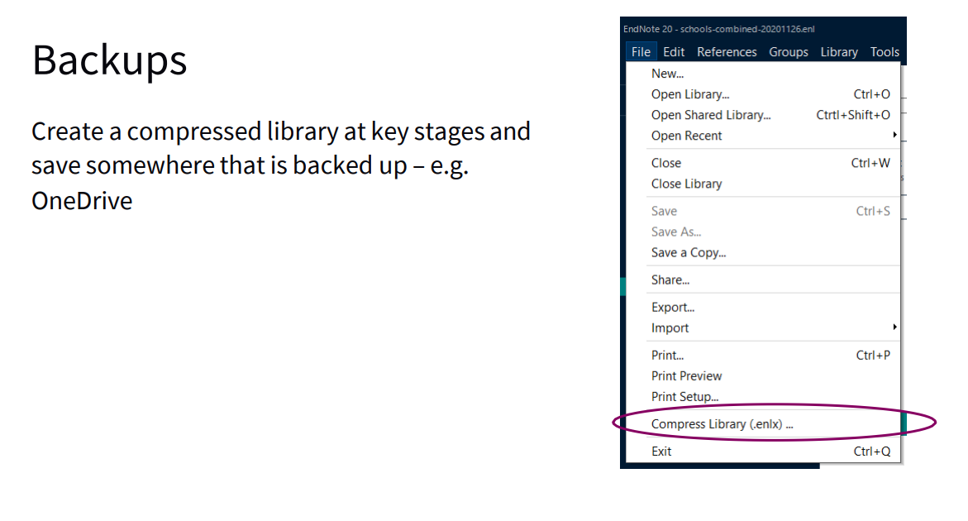

Slide 21
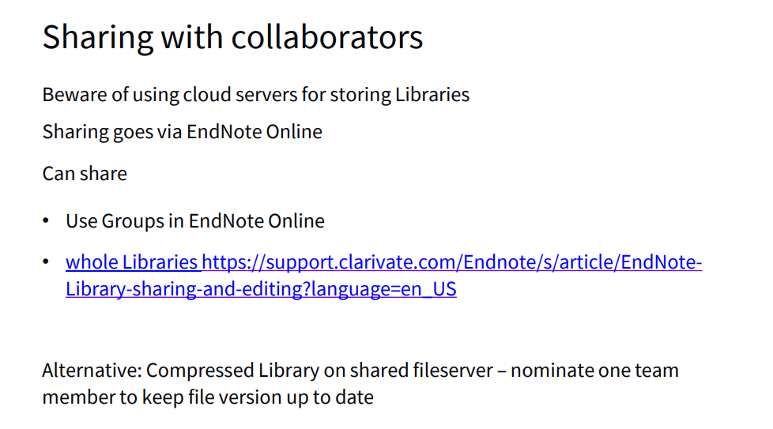


Slide 22
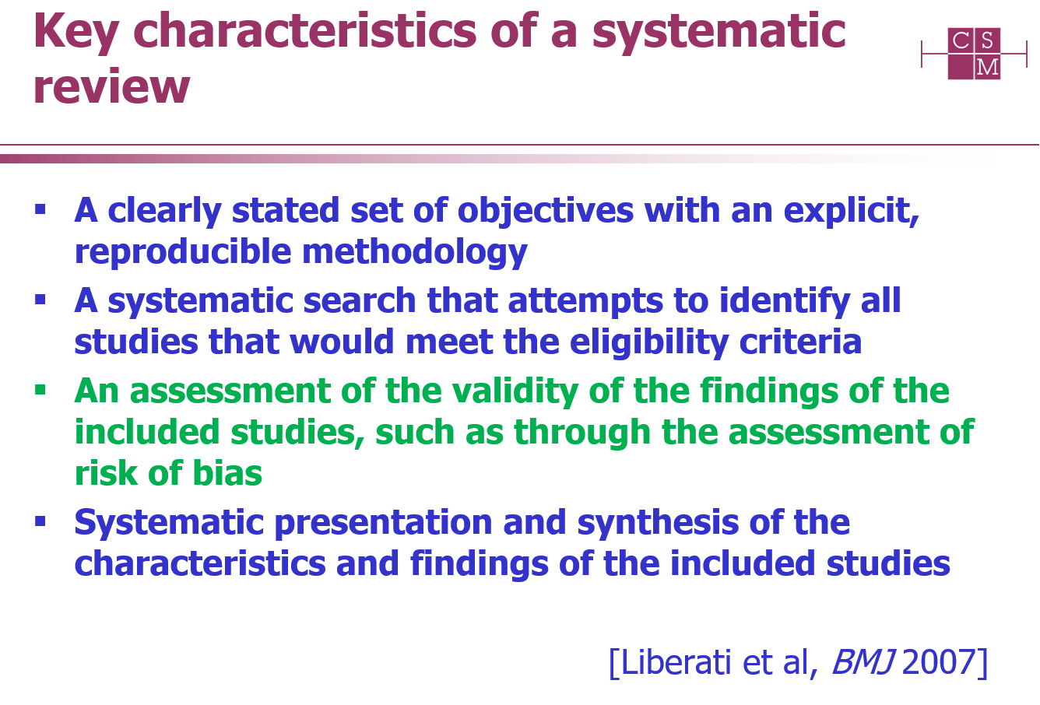

Slide 23
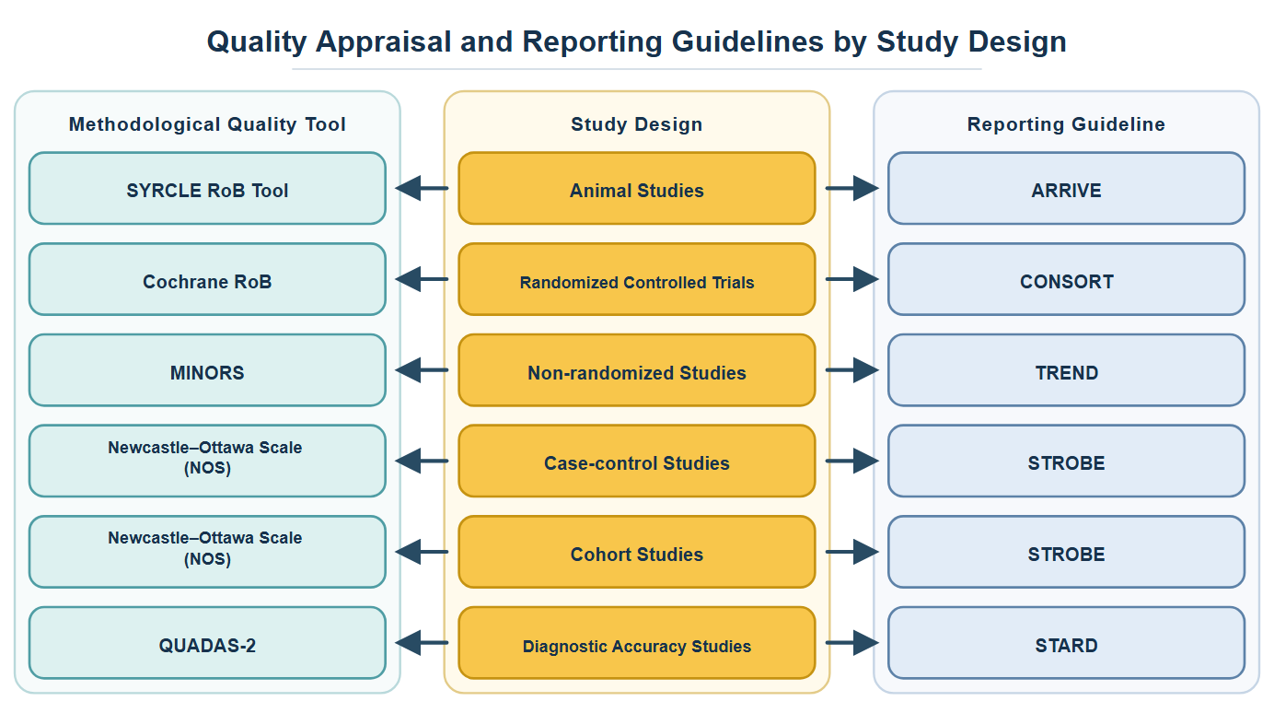

Slide 24


Slide 25
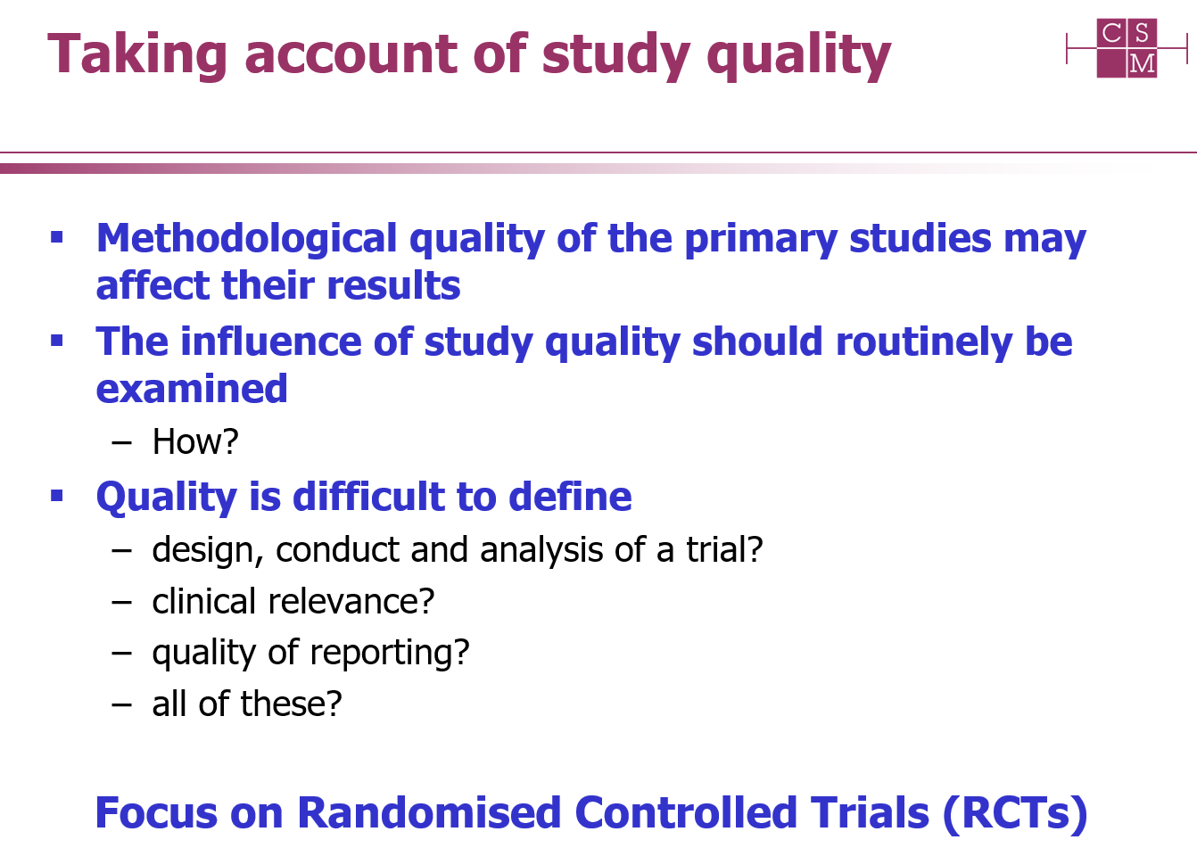

Slide 26
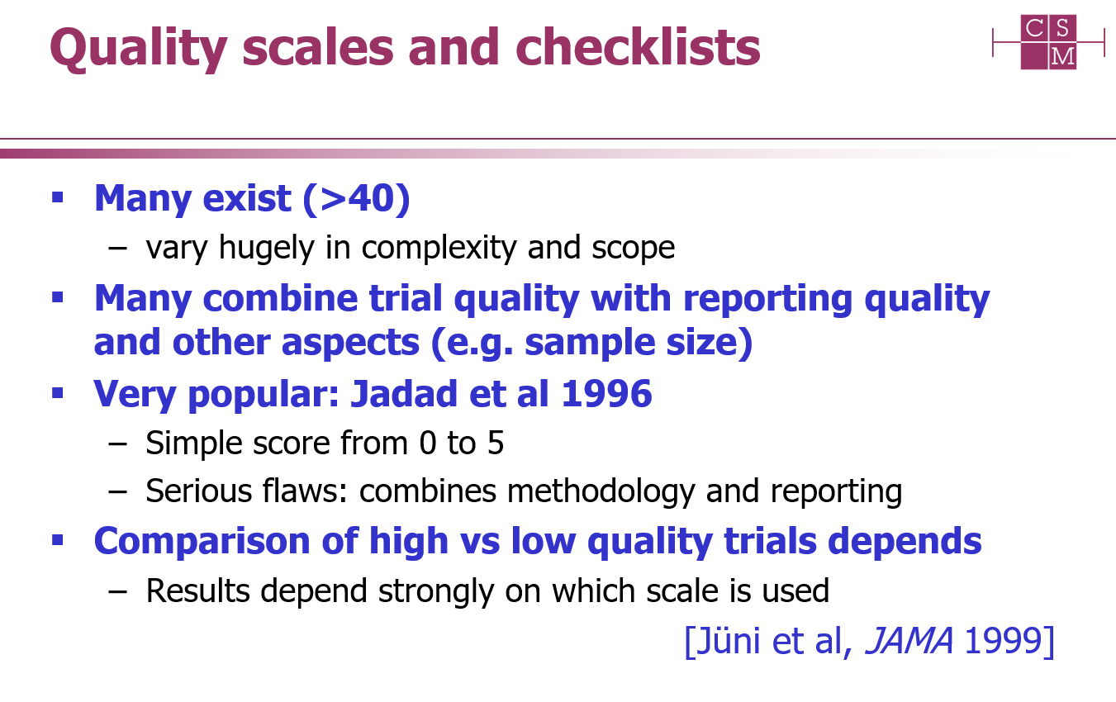

Slide 27
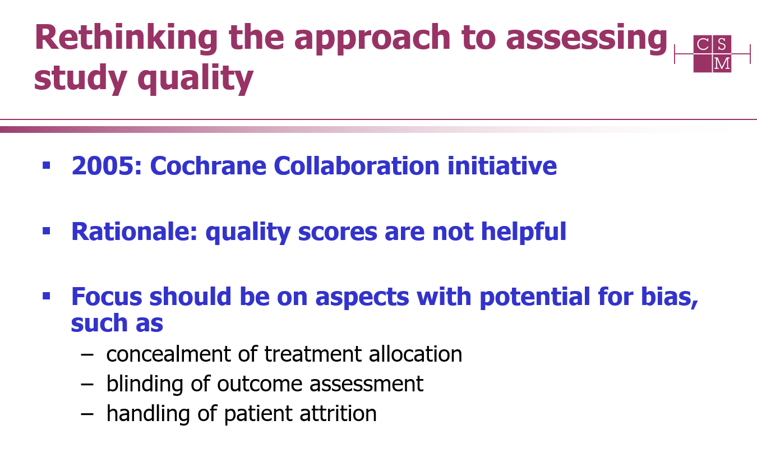

Slide 28
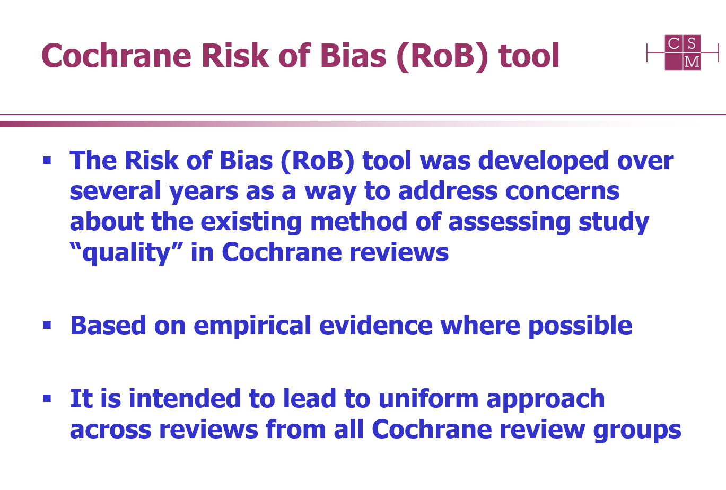

Slide 29
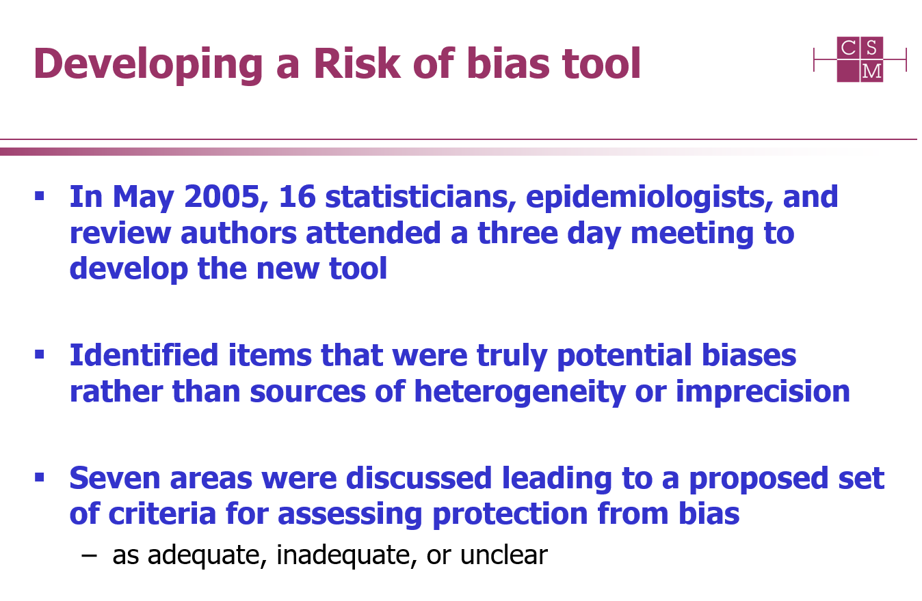

Slide 30
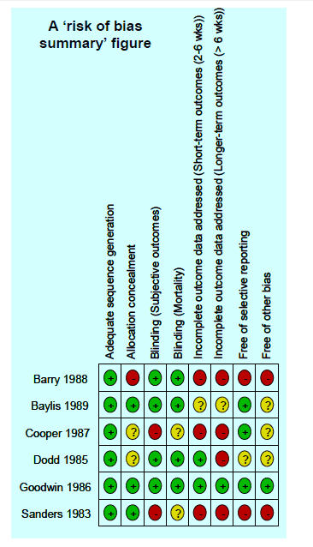
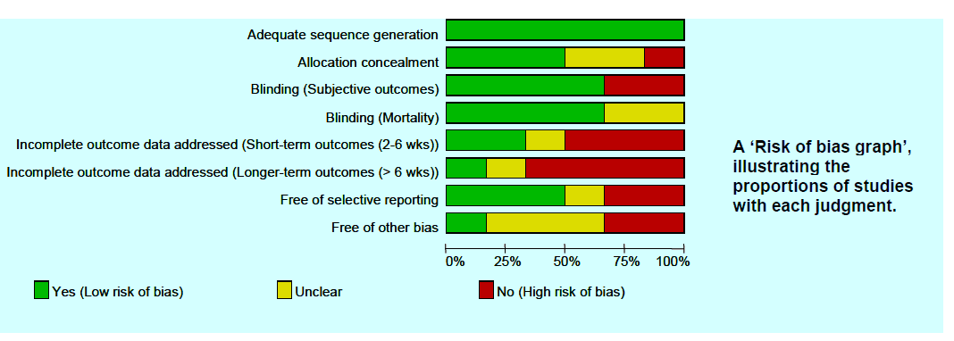
Cochrane Risk of Bias

Slide 31
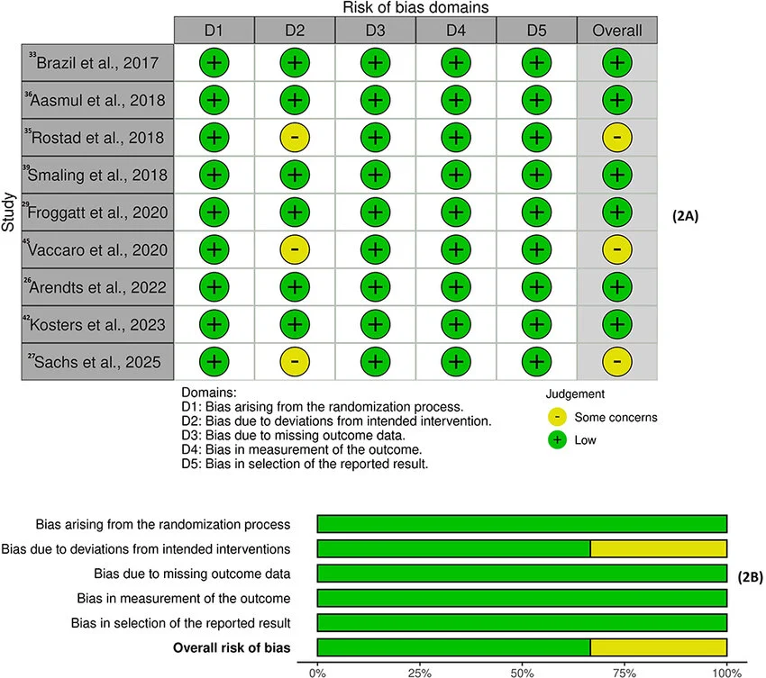
Cochrane Risk of Bias 2

Slide 32
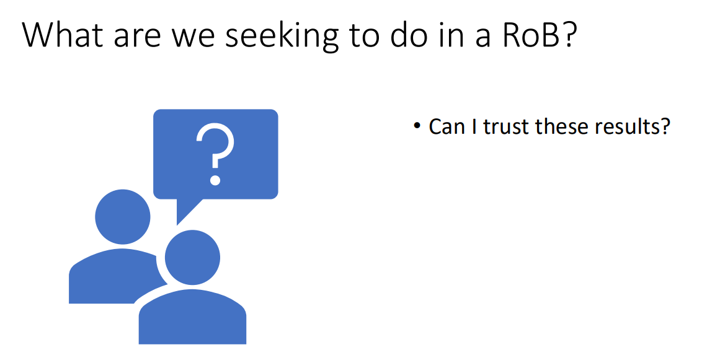

Slide 33
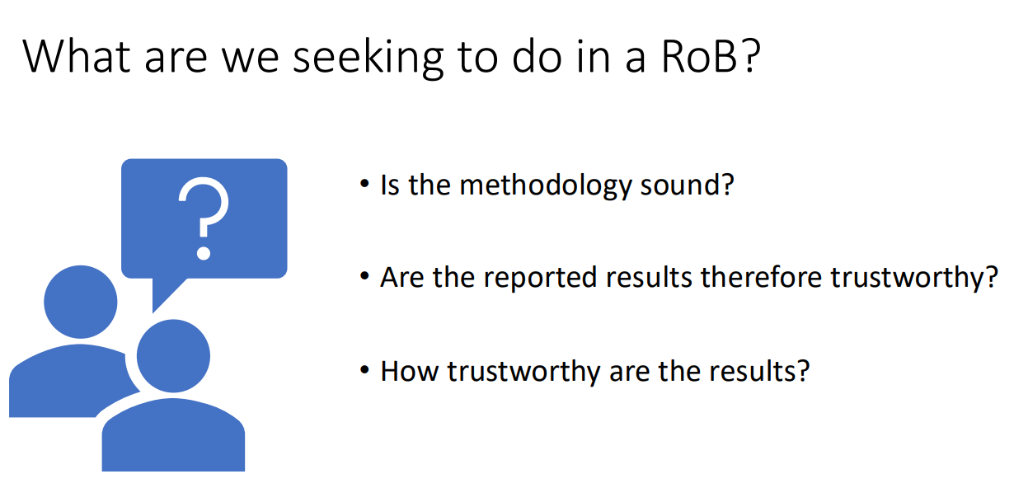

Slide 34
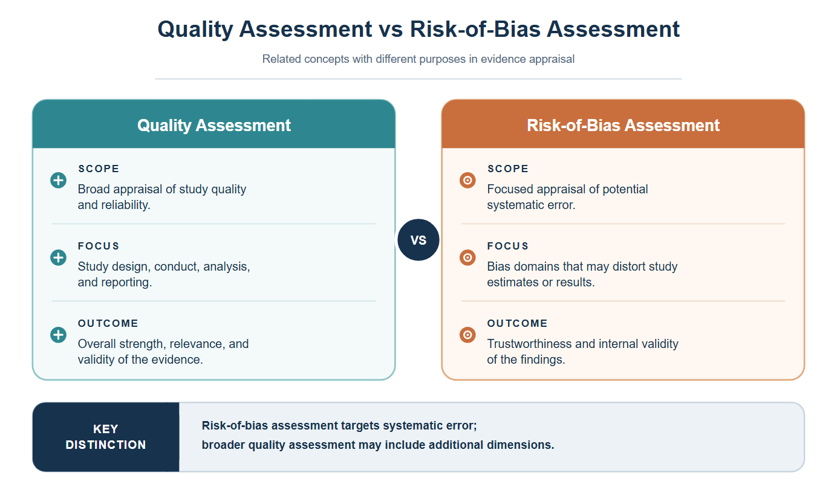

Slide 35
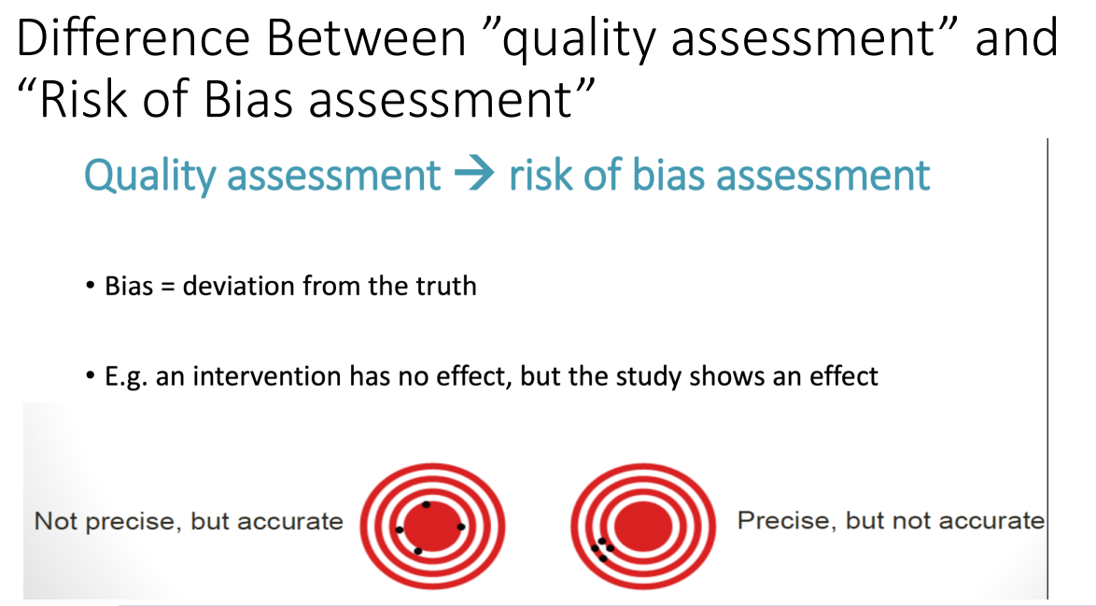

Slide 36
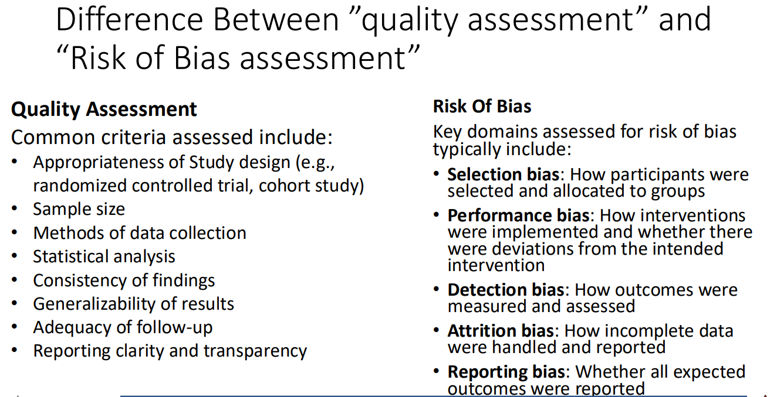

Slide 37
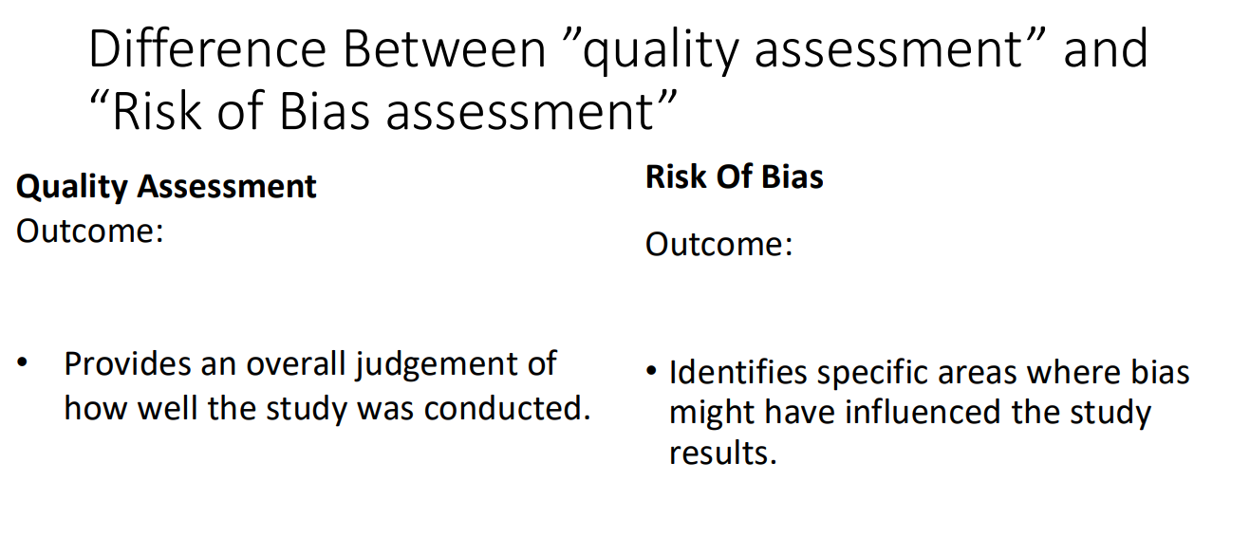

Slide 38
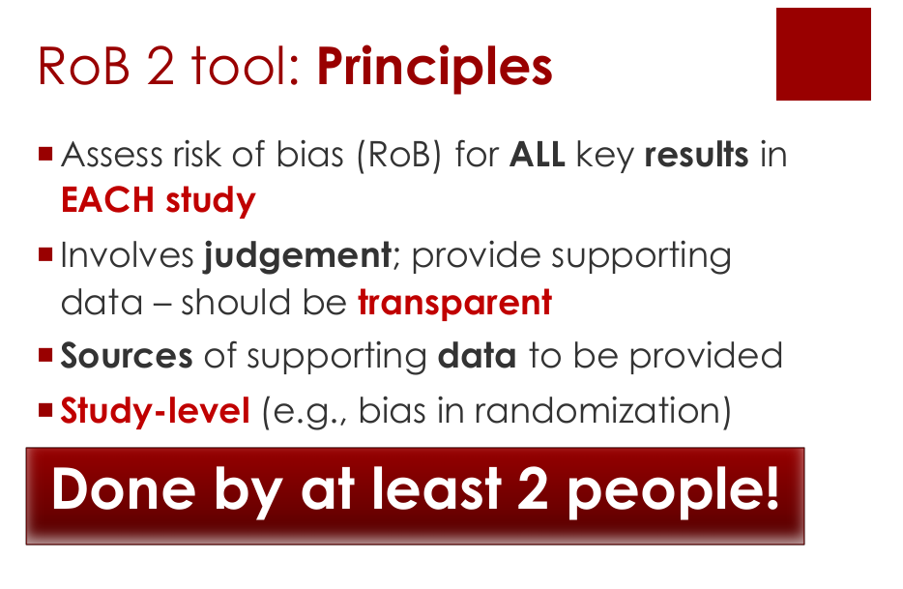

Slide 39
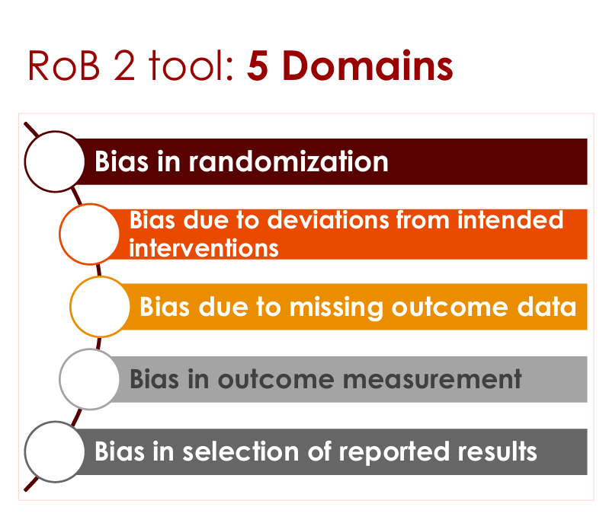

Slide 40
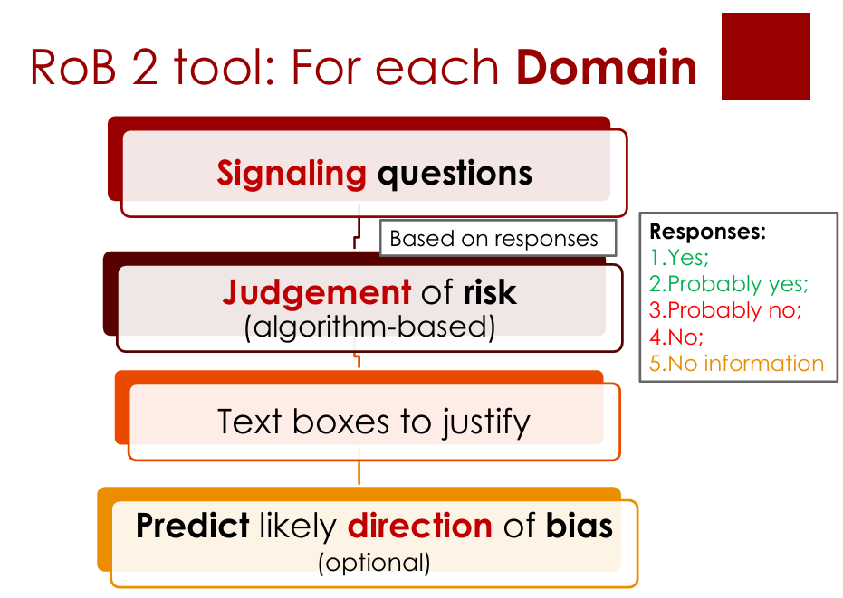

Slide 41
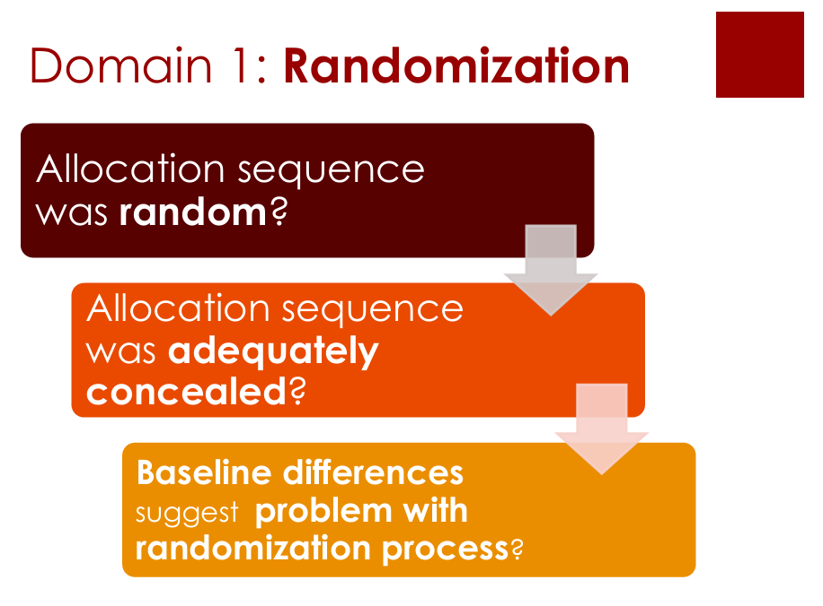

Slide 42
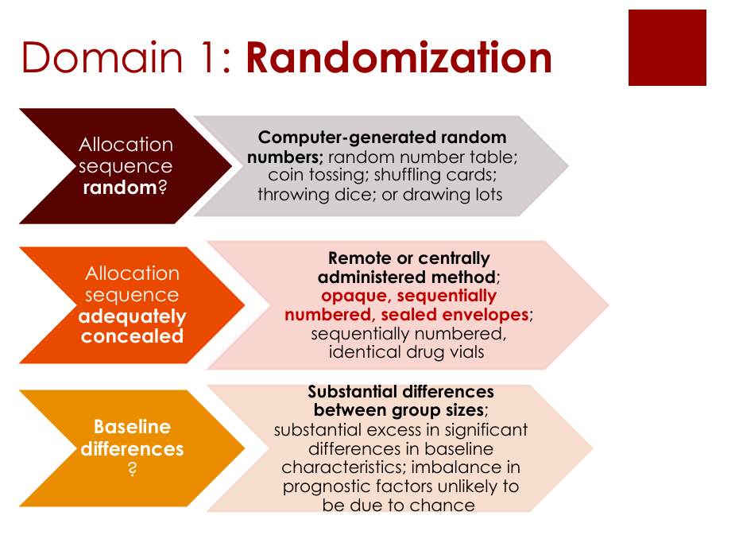

Slide 43
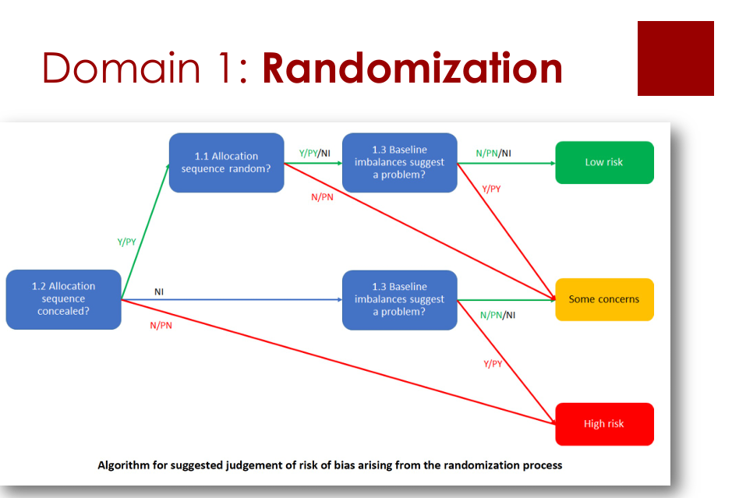

Slide 44
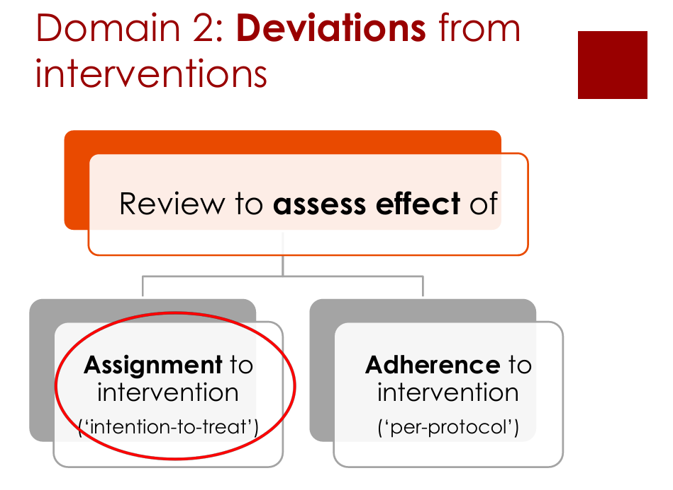

Slide 45
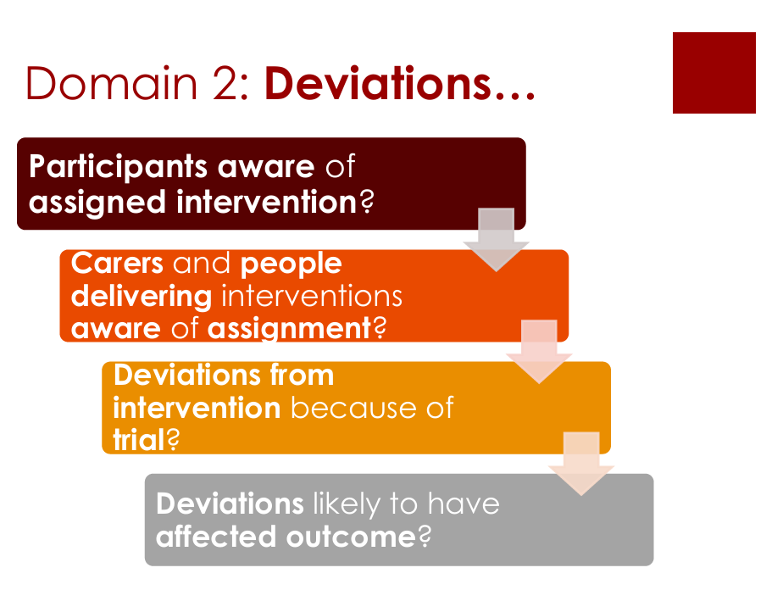

Slide 46
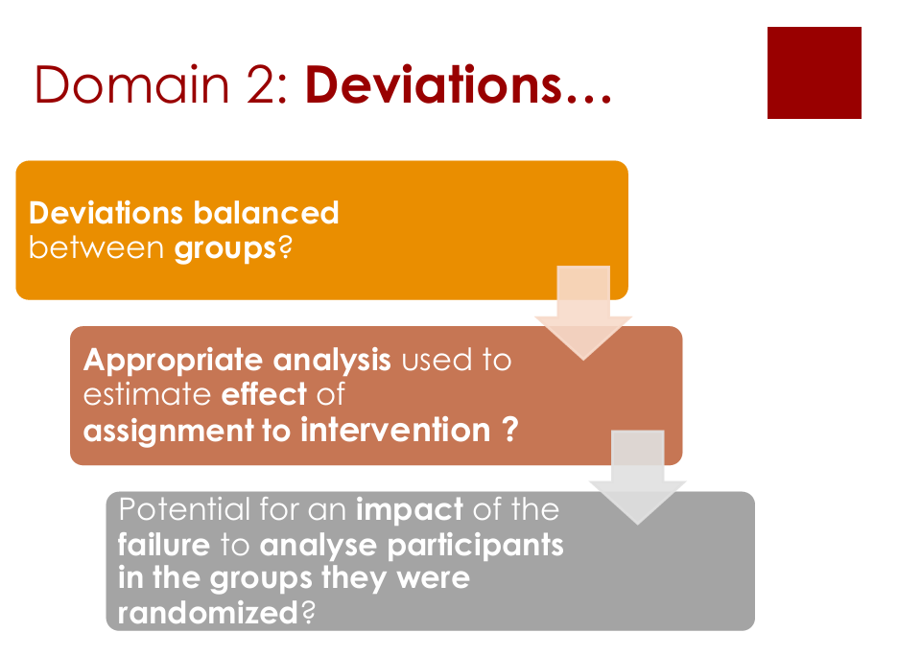

Slide 47
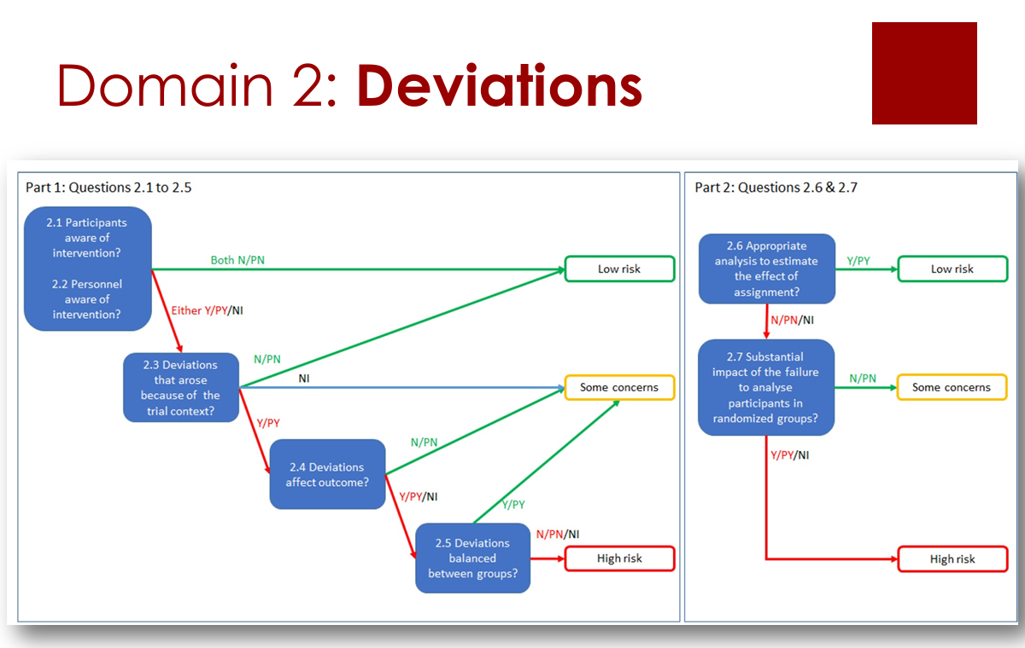

Slide 48
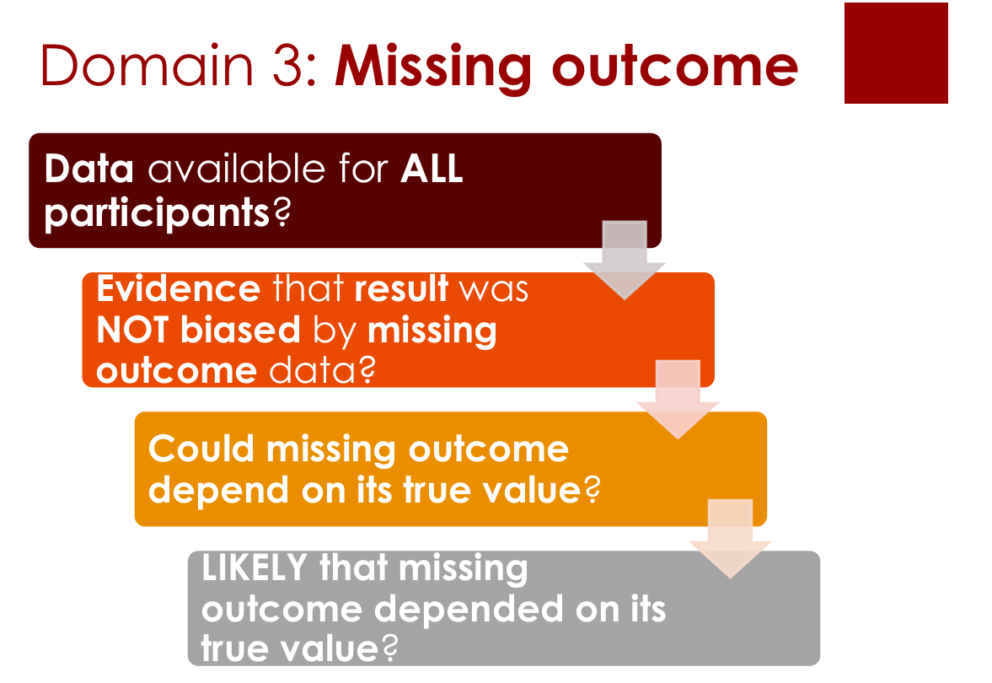

Slide 49
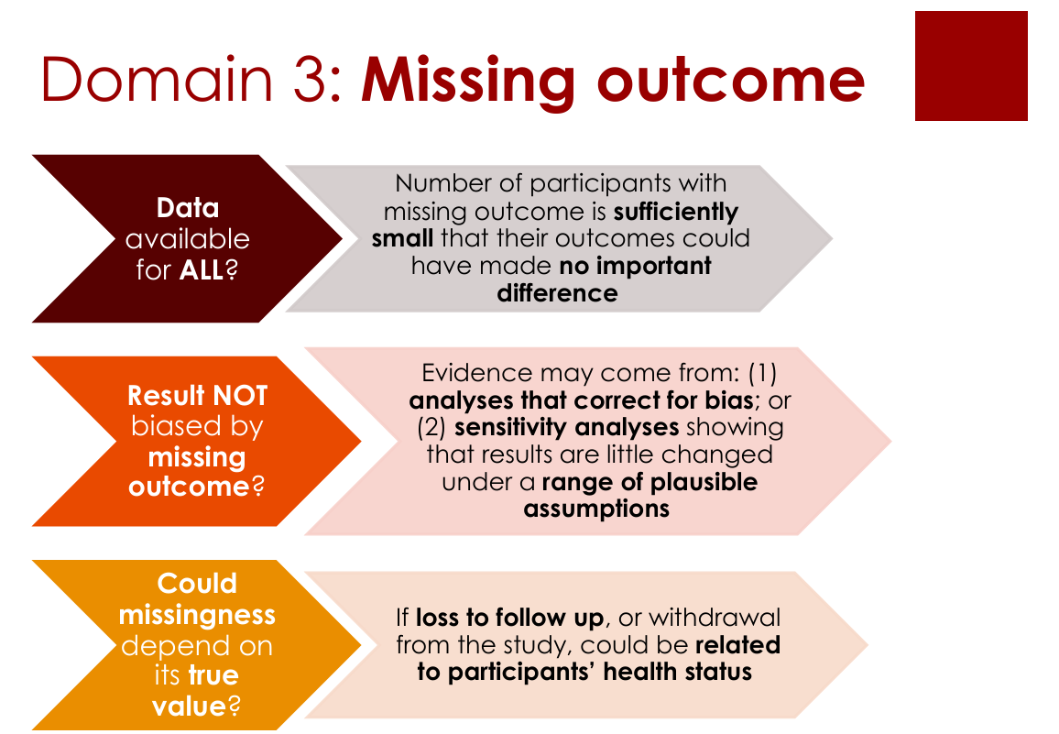

Slide 50
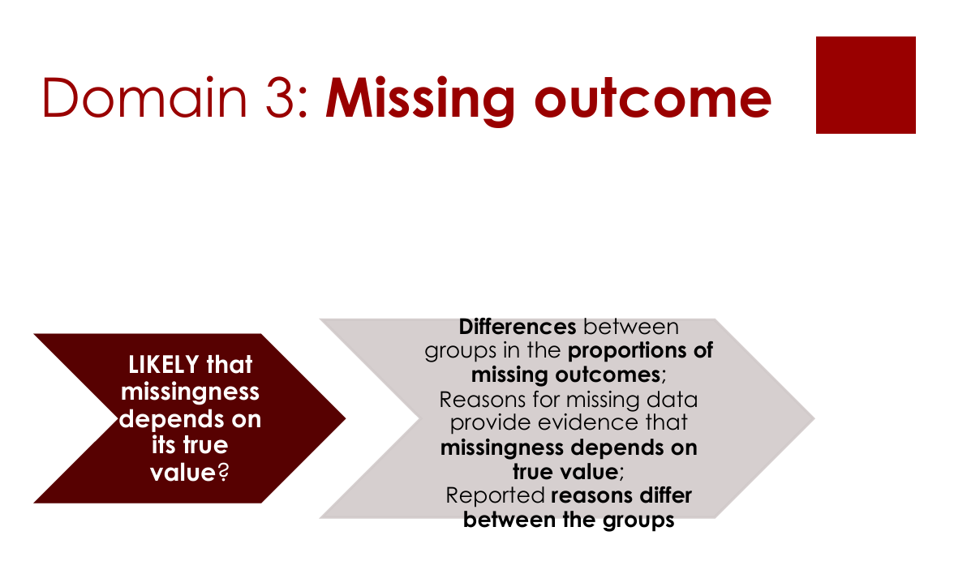

Slide 51
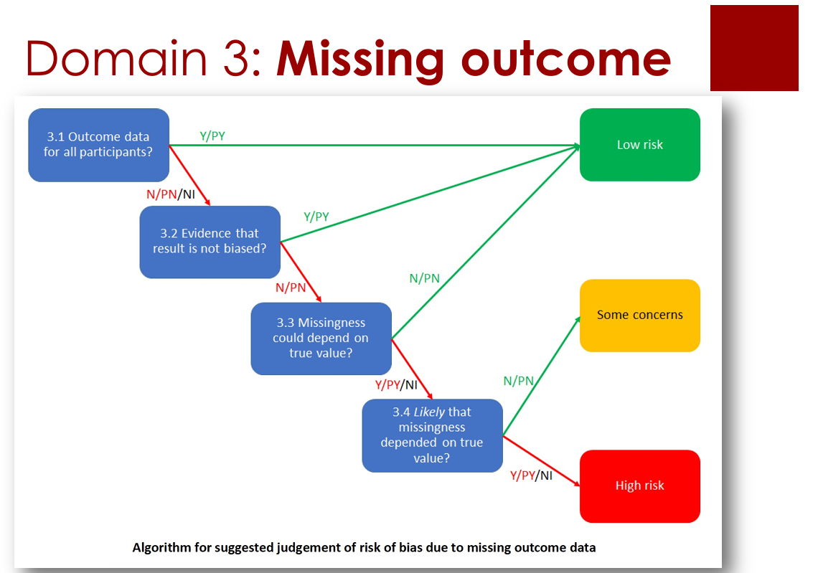

Slide 52
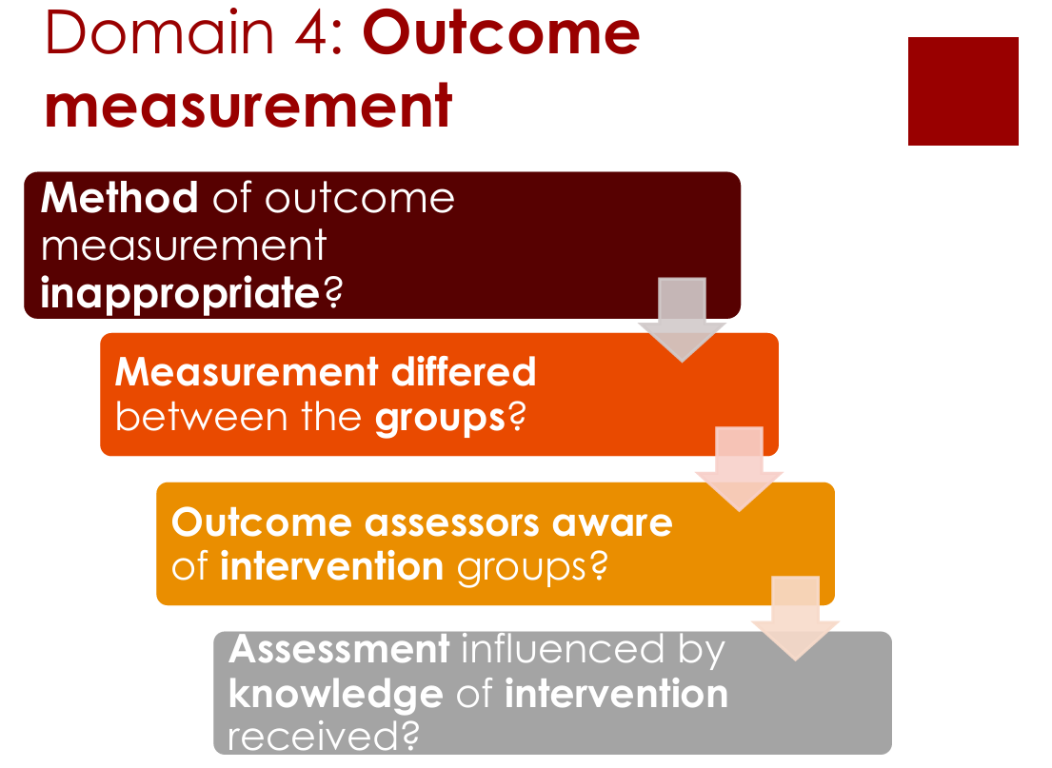

Slide 53
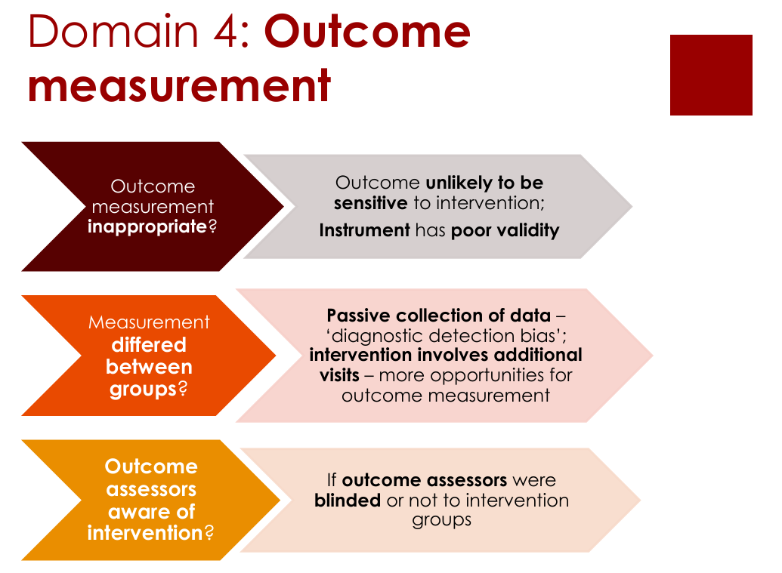

Slide 54
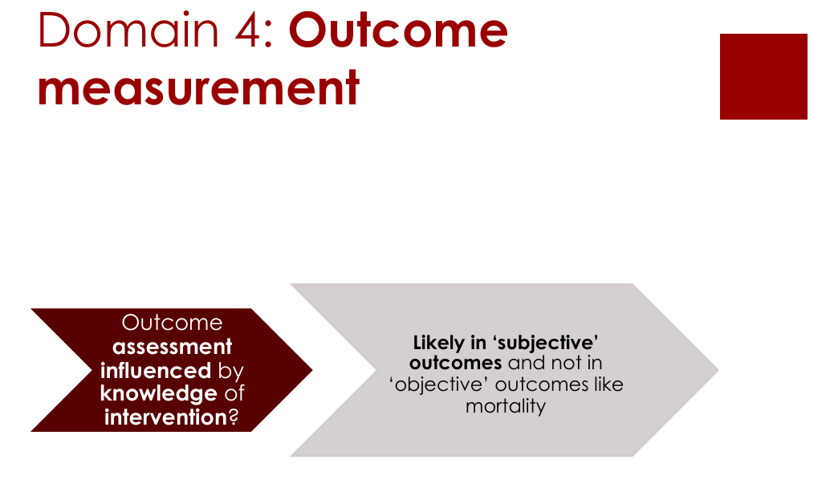

Slide 55
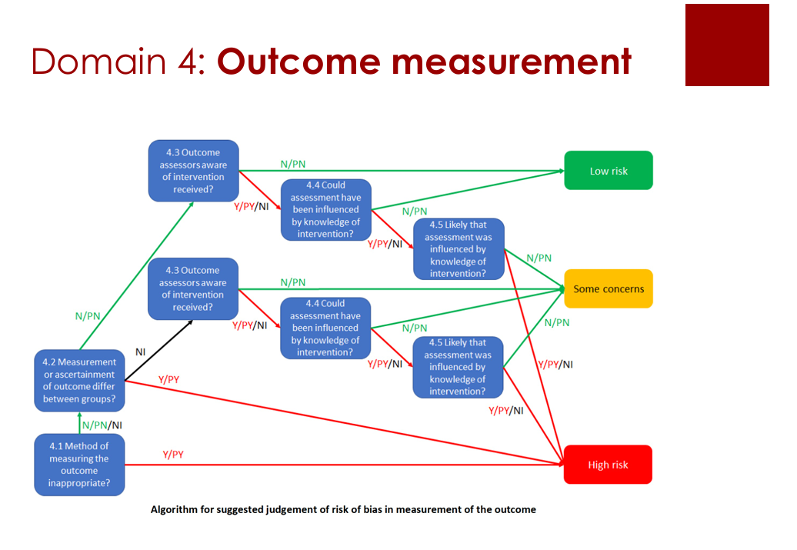

Slide 56


Slide 57


Slide 58


Slide 59



Slide 60
Simulated study description
A total of 200 participants were randomly assigned in a 1:1 ratio to Drug A or a matching placebo, with 100 participants in each group. An independent statistician generated the allocation sequence using a computer. Allocation was implemented through a central randomization system, and recruiting personnel could not predict upcoming assignments. Baseline differences did not suggest a problem with randomization.
Participants, personnel delivering the interventions, and outcome assessors were blinded to treatment allocation. Drug A and the placebo were identical in appearance, and blinding was maintained.
All 200 participants completed the Week 8 blood pressure assessment and were analyzed in their originally assigned groups. No participants were excluded after randomization.
Both groups were assessed using the same validated electronic blood pressure monitor and standardized measurement procedures.
The protocol and statistical analysis plan were finalized before unblinding and specified the outcome, assessment time point, and analysis method. The reported result followed this plan, with no selection of measurements, time points, or analyses based on the findings.

Slide 61

robvis is a web app designed to for visualizing risk-of-bias assessments performed as part of a systematic review.

Slide 62

Modified Jadad Scale

Slide 63



Slide 64


Slide 65

Why bother about grading evidence?
People draw conclusions about
  Quality of evidence
  Strength of recommendations
Systematic, explicit approaches help
  Facilitate critical appraisal
  Protect against errors
  Resolve disagreements
  Communicate information
GRADE Working Group (2004)

Slide 66

Grading of Recommendations Assessment,
Development and Evaluation
System (and common language) that
  was developed and updated by GRADE Working Group
  has been endorsed by large number of organisations
  expresses degree of confidence one can place in quality of evidence and strength of recommendation
System for assessing quality of evidence of a body of evidence based on
  study design
  criteria for downgrading/upgrading
GRADE Working Group (2004); Guyatt et al (2008)

Slide 67
Rating quality of evidence

Slide 68
GRADE quality of evidence
Definition: The degree of confidence in an estimate of effect.
High (++++) | We are very confident that the true effect lies close to that of the estimate of the effect.
Moderate (+++) | We are moderately confident in the effect estimate: The true effect is likely to be close to the estimate of the effect, but there is a possibility that it is substantially different.
Low (++) | Our confidence in the effect estimate is limited: The true effect may be substantially different from the estimate of the effect.
Very low (+) | We have very little confidence in the effect estimate: The true effect is likely to be substantially different from the estimate of the effect.

Slide 69
Determinants of quality of evidence (1)
Study design:
Bodies of RCTs start as high
All other study designs start as low
Upgrading/downgrading criteria:
Five factors can decrease quality of evidence
Three factors can increase quality of evidence
RCTs versus observational study designs usually run through assessment separately

Slide 70
Determinants of quality of evidence (2)
Quality | Study design | Lower quality if: | Higher quality if:
High (++++) | Randomised controlled trials | Risk of bias (-1, -2) Inconsistency (-1, -2) Indirectness (-1, -2) Imprecision (-1, -2) Publication bias (-1, -2) | Large effect (+1, +2) Dose-response (+1) Direction of residual confounding and biases (+1)
Moderate (+++)
Low (++) | Observational studies
Very low (+) | Case reports, expert opinion, modelling

Slide 71
Risk of bias (-/--)
Risk of bias:
Limitations in study design and execution with relevance to given outcome, based on quality appraisal of individual studies
Indicators of risk of bias
  Moderate or high risk of bias across most studies
  etc.
Lower quality of evidence
  -1 if serious limitations in study design and execution
  -2 if very serious limitations in study design and execution

Slide 72
Inconsistency (-/--)
Consistency:
Similarity of estimates of effect across studies
Indicators of inconsistency
  Differences in direction of effect
  Variation in size of effect
  Large I² value
  etc.
Distinguish between
  explained heterogeneity (e.g. population, intervention, outcome)
  unexplained heterogeneity
Lower quality of evidence
  -1 if large unexplained inconsistency
  -2 if very large unexplained inconsistency

Slide 73
Indirectness (-/--)
Directness:
Extent to which populations, interventions, comparisons and outcomes are similar to those of interest
Indicators of indirectness
  Very different populations (e.g. age, sex, illness)
  Surrogate outcomes
  No direct comparisons
  etc.
Lower quality of evidence
  -1 if serious uncertainty about directness
  -2 if very serious uncertainty about directness

Slide 74
Imprecision (-/--)
Precision:
Is a consequence of sample size and number of events
Indicators of imprecision
  Small population (sparse data)
  Small number of events
  Wide confidence intervals around pooled effect (e.g. including RR=1)
  etc.
Lower quality of evidence
  -1 if imprecise or sparse data
  -2 if very imprecise or sparse data

Slide 75
Publication bias (-/--)
Publication bias:
Systematic under- or overestimate of effect due to selective publication of studies
Indicators of publication bias
  Small studies
  Industry-sponsored studies
  Asymmetric funnel plot
  etc.
Lower quality of evidence
  -1 if publication bias is strongly suspected
  -2 if publication bias is very strongly suspected

Slide 76
Three factors for upgrading
Large or very large effects are less likely to be spurious
  +1 if relative risk reduction ≤ 0.5 or risk ratio ≥ 2
  +2 if relative risk reduction ≤ 0.8 or risk ratio ≥ 5
Evidence of dose-response gradient
  +1 if dose-response gradient observed
If effect observed: All plausible residual confounding and biases would have reduced effect
If no effect observed: All plausible residual confounding and biases would have increased the effect
  +1 if appropriate direction of residual confounding and biases

Slide 77
Grading strength of a recommendation

Slide 78
GRADE strength of recommendation
Definition: The degree of confidence that desirable effects of adherence to a recommendation outweigh undesirable effects.
Strong recommendation:
The panel is confident that the desirable effects of adherence to a recommendation outweigh the undesirable effects.
Weak/ conditional/ discretionary recommendation:
The panel concludes that the desirable effects of adherence to a recommendation probably outweigh the undesirable effects, but is not confident.

Slide 79
Low quality of evidence, strong recommendation?
Clear distinction between
  quality of evidence, driven by confidence in body of evidence
  strength of recommendation, driven by confidence in body of evidence plus other considerations
All combinations possible, e.g.:
  High quality of evidence -> weak recommendation
  Very low quality of evidence -> strong recommendation
Paradigmatic situations for strong recommendations in the absence of high-quality evidence (Alexander et al. 2016)

Slide 80


Slide 81




Slide 82


Slide 83






Team for AI-Empowered Smart Healthy Ageing
Li Kefeng
Associate Professor
Tel: (853) 8599 3824
Email: kefengl@mpu.edu.mo
Qiu Huang
Associate Professor
Tel: (853) 8599 3873
Email: qhuang@mpu.edu.mo
Hsuan Yu Lu, James
Lecturer
Tel:(853) 8599 3825
Email：hylu@mpu.edu.mo
Wenwang Rao
Lecturer
Tel:(853) 8599 3826
Email: raoww@mpu.edu.mo

Slide 84





